Slide 1
Trust and school improvement support 2022 to 2023 academic year including 2023/24 delivery
Yorkshire and the Humber and the North West RDP
Great Heights Academy Trust is the strategic DfE Delivery Partner for the DfE TSIO 22/23 in YH and NW regions
Great Heights Academy Trust
Trust and school improvement offer - GOV.UK (www.gov.uk)
Version 6
Wednesday 12th July 10-12
at
The Mirfield Free Grammar School, West Yorkshire, WF14 9EZ

Slide 2
The session will explain more about the TSIO offer by covering:
Connection for system leaders to the TSIO RDP (NW and YH) teams, outlining TSIO offer opportunities / guidance for 23/24 and delivery into 23-24.
Insight into the matching and delivery role of the system leader - presentation and discussions
TSIO case studies and lessons learnt from system leader colleagues - presentation and discussion
Maximising the funded use of DfE approved programmes - updates from hubs
Opportunity to indicate your capacity and expertise ready for potential future matching in 23/24 - update
Strong trusts as the source and providers of system leadership capacity - introductory presentation
Gathering your feedback on your involvement with TSIO delivery so far - plenary

Slide 3
Unconferencing … Sharing your capacity …
To inform this and future sessions, on a post-it note write down a key priority/question/area for discussion that you would like to explore with colleagues.
To inform our matching please add your capacity details to our matching records.
Thank you

Slide 4
The essential role of commissioned, strong system leaders ‘The role of system leaders in delivering the TSI offer is so important – your leadership and expertise will provide the foundations for sustained and strengthened school improvement in our most vulnerable schools and trusts, including recovery from the impact of the pandemic, and the longer-term capacity to deliver continuing improvement. The TSI offer is a core aspect of a sector-led school improvement strategy and the Department for Education’s (DfE) work with schools and trusts through our regional teams. I want to thank you personally for giving your time and expertise to make a fundamental difference for schools and trusts, and ultimately for children and their educational experience and attainment.’ Trust and school improvement offer - GOV.UK (www.gov.uk)
September 2023

Slide 5
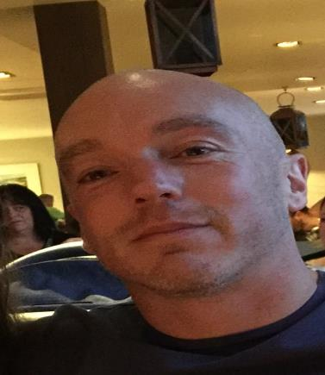
DfE – Yorkshire & Humber Regions Group
Who I am
I’m Russ White and I work in the Yorkshire & Humber Regions Group.
My role
I am the Trust & School Improvement (TSI) regional lead for the Yorkshire and Humber region – I work in partnership with our TSI Regional Delivery Partner, with the aim of identifying and implementing the most suitable TSI matches for eligible schools.
I also work closely with trust leaders, local authorities and Diocese Education Leads to ensure join up across the sector and ensuring key stakeholders have a role to play in the TSI matching process.
I monitor and evaluate the impact of the offer and its link to school improvement, reporting outcomes and findings to ministers.
Regional Profile
In the Yorkshire and Humber region, we cover 15 local authority areas including: Barnsley, Bradford, Calderdale, Doncaster, East riding, Kingston-upon-Hull, Kirklees, Leeds, North East Lincolnshire, North Yorkshire, Rotherham, Sheffield, Wakefield and York.
Currently in the Yorkshire and Humber regions we have 124 MATs and 67 SATs.
We have 2,219 schools (1,212 academies and 1,007 LA maintained schools). 82.1% of academies and free schools are good or outstanding for Ofsted purposes.
To-date in the 2022/23 academic year, we have made the TSI offer to over 80 schools and trusts.
Russ White
Russell.White@education.gov.uk

Slide 6
Regions Group priorities
Build sector improvement capacity:
Establishing support for vulnerable schools, authorities and trusts (including ESFA support)
Introducing good free schools in the right place at the right time (including for SEND)
Deliver reform:
Supporting every school joining a strong trust,
Designing a mature and sensible trust landscape, including establishing new trusts where we need them
More deliberate trust design through ‘area-based commissioning’ with capacity funding in high need LAs
Implementing the SEND and alternative provision improvement plan and the children’s social care review implementation strategy
Support vulnerable and failing schools, trusts (and LAs) intervening where needed
Increase attendance in schools (working with partners)
Recognising the impact of the pandemic and understanding financial pressures/cost of living

Slide 7
TSI offer – 2023/24
Development of TSI offer for 23/24:
Anticipate a similar offer to the 22/23 one and a similar approach to system leader support through sponsor trusts and NLEs.
Currently reviewing eligibility criteria and any adjustments to the programme in advance of finalising.
Taking into account feedback received so far from supported schools/trusts and supporting sponsor trusts/NLEs – we welcome further reflections on implementation of this year’s offer.
Anticipate launching new offer soon after the start of the new academic year.
Schools will continue to become eligible for 22/23 offer until end of the current AY and will be matched in the autumn term.

Slide 8
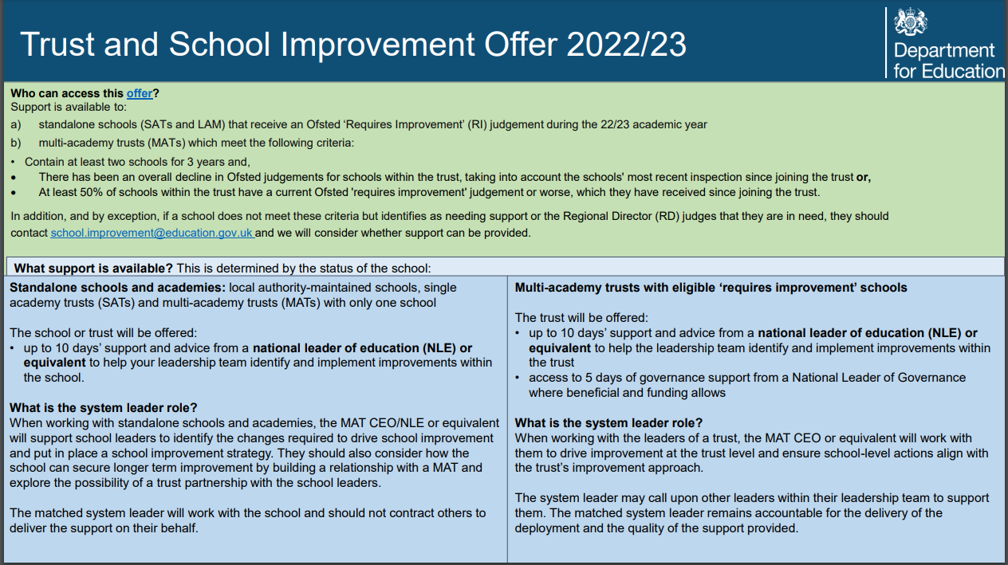
TSI Offer
It is vital system leaders engage with the recipient school/trust in a way that builds both understanding of current context, strengths and needs and a relationship of transparency and trust.
Without these two components, it is unlikely that support provided will be aligned effectively to address areas of need or will be received and acted upon positively and productively.
System leaders are expected to take full ownership of co-ordinating the support offer and delivering most of the support required.
Ref p5 DfE System Leaders TSIO Guidance 2022/23
https://greatheightstrust.org.uk/22-23-tsio-system-leader-materials/

Slide 9
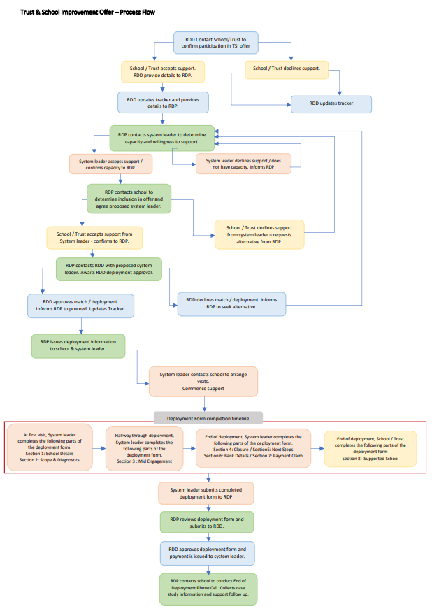
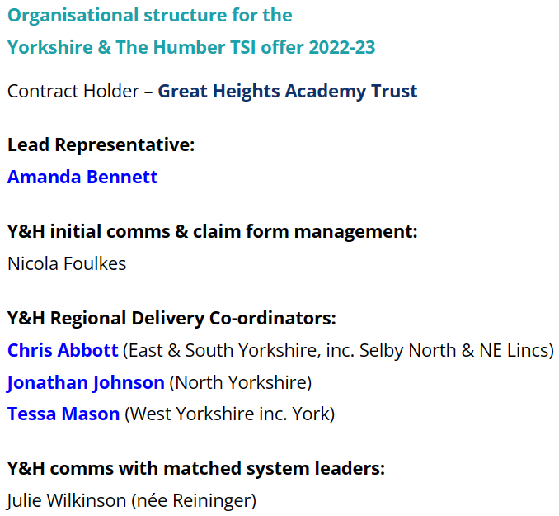
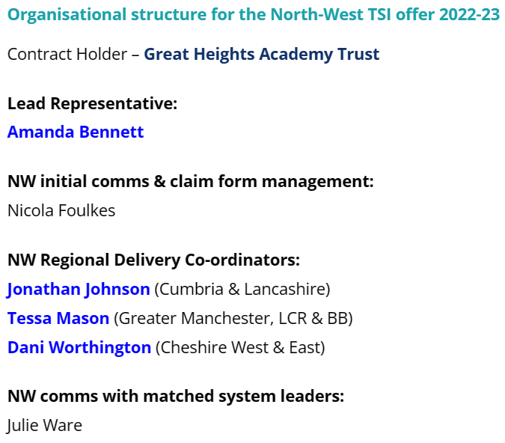
Insight into the matching and the delivery role of the system leader
Pages 10-12 in the System Leader Guidance identifies the matching process

Slide 10
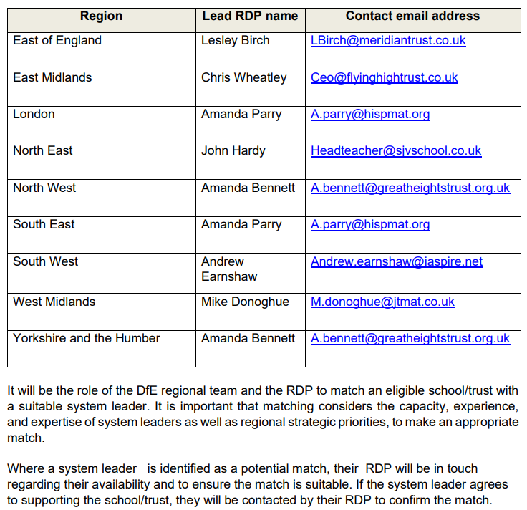
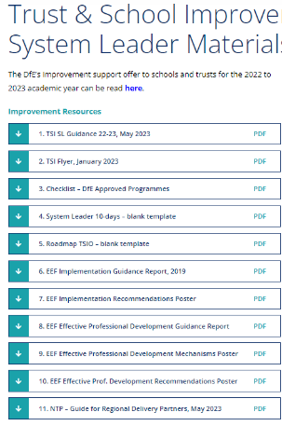
Understanding the role
System leader tools to support positioning …
Who are your local Regional Delivery Partners?

Slide 11
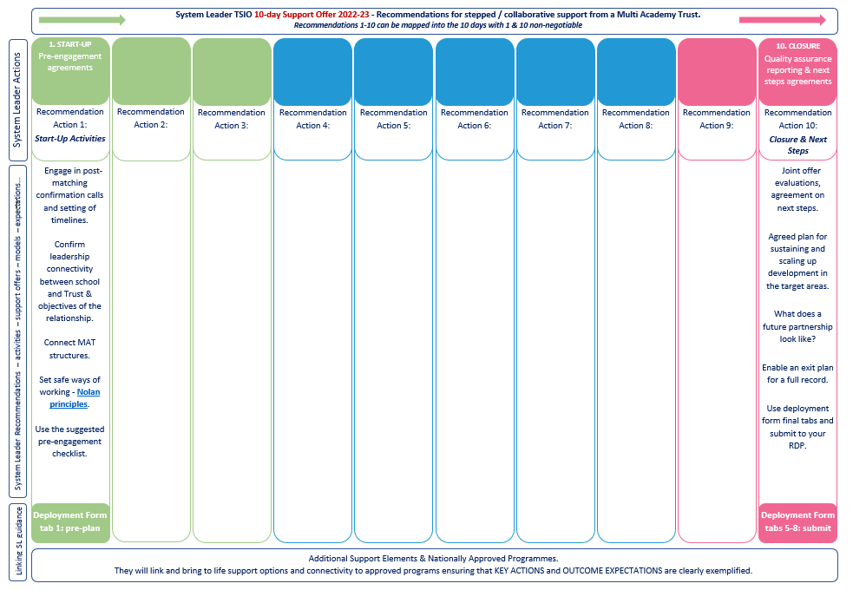
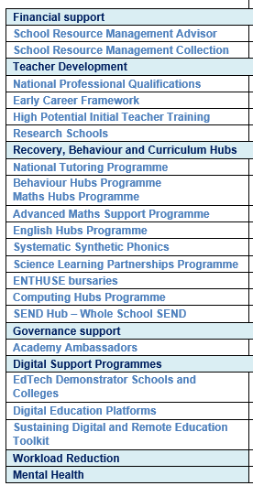
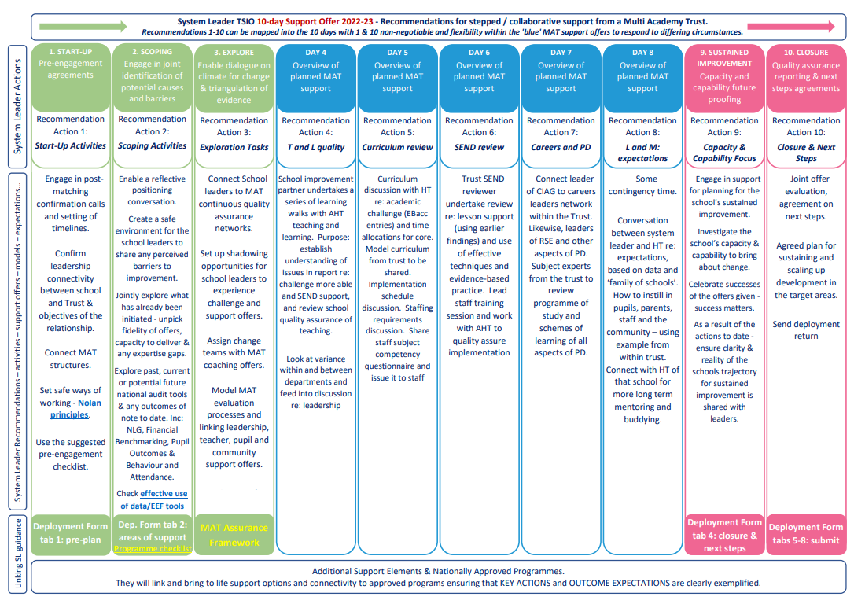
Planning your delivery …

Slide 12
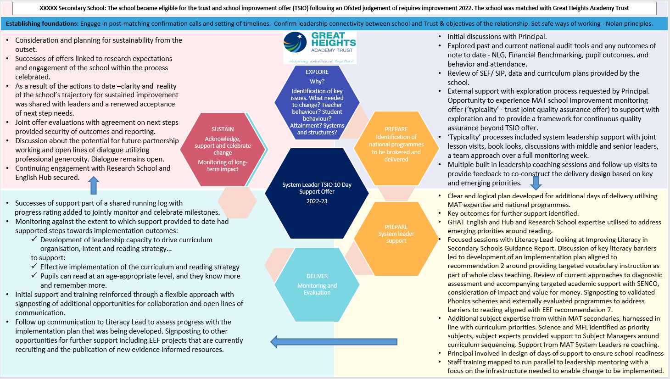
Case Study Process Map - discussion

Slide 13
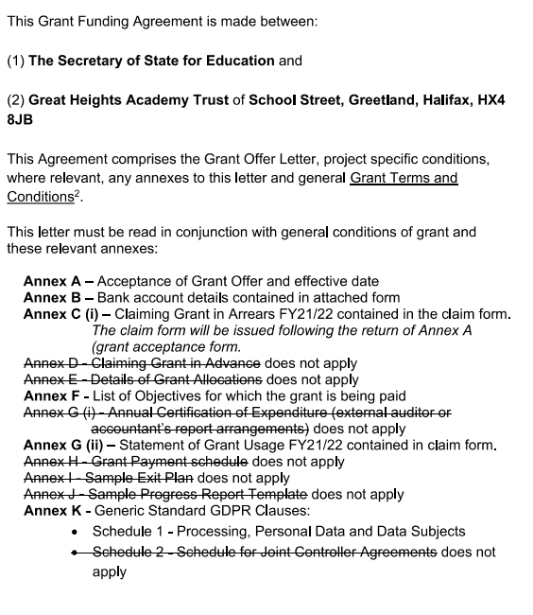
Grant Offer Letters …

Slide 14
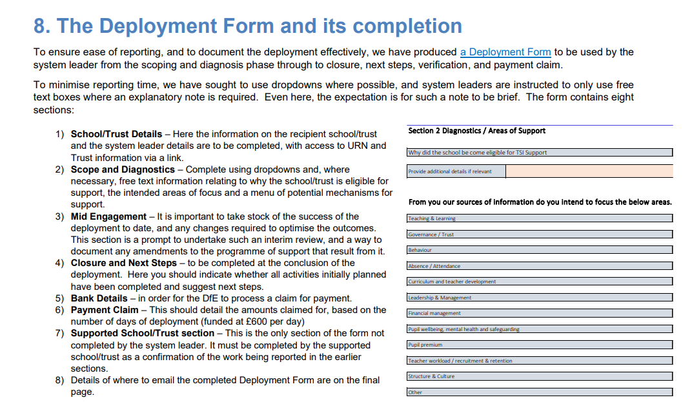
Deployment Forms…
Our TSIO bank of resources, newsletters & links are available at https://greatheightstrust.org.uk/22-23tsiowebpages/

Slide 15
Feedback…
Do capture any feedback to us on the matching and delivery aspect of TSIO
Thank you
Next – Hub updates

Slide 16
Adam Harris
English Hub Lead

Slide 17
Strategic and Governance oversight
English Hub Board
Hub Strategic Lead - Helen Crowther
Delivery Leadership Team
Hub Lead - Adam Harris
Deputy Hub Lead – Lianne De Villiers
Delivery and Administrative Team
14 Literacy specialists
2 admin support 1 Finance support
6 Auditors

Slide 18
English Hubs Programme priorities
In the Schools White Paper, the department committed to an ambition that by 2030, 90% of pupils should reach expected standards in reading at end of KS2 as part of the government’s commitment to boosting education standards. The English Hubs programme aligns to supporting this ambition by driving up standards in early reading and supporting a full school commitment to reading.

Slide 19
All support offered by the hub will promote at least one of the programme’s priorities outlined below. SSP is the first and main priority.
Age-appropriate phonics provision: encouraging best practice in SSP teaching from Reception to the end of Key Stage 1, and as the primary reading strategy throughout the school. This includes:
Encouraging fidelity to a single SSP programme
Supporting the effective use of decodable books in the early stages of learning to read, as a way of establishing phonic decoding.
Supporting effective practice in formative assessment in relation to phonics/early reading.

Slide 20
Promoting a love of reading: encouraging reading for enjoyment including by supporting whole school reading approaches, reading to children at least once a day and encouraging reading at home, developing teachers’ knowledge of appropriate children’s literature.
Early language development: providing evidence-based approaches to early language development and closing the word gap in school-based early years settings.

Slide 21
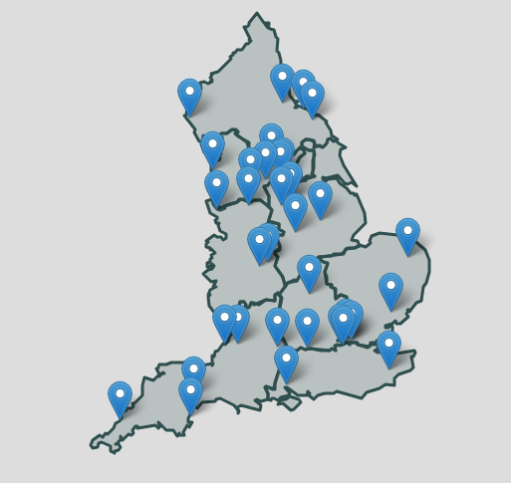
National Reach
englishhub@greetlandacademy.org.uk
01422 761019
https://greatheightsenglishhub.org

Slide 22
National Tutor Programme… updates & support
New Tutoring Excellence Seminars (CPD) from EDT
EDT have now developed some seminar-style live online CPD, focused on key areas of tutoring pedagogy. The seminars are 90-minutes long and offer a choice of topics, with best-practice sharing opportunities built into the sessions.
https://greatheightstrust.org.uk/wp-content/uploads/2023/05/11.-NTP-Guide-for-Regional-Delivery-Partners_v2.pdf

Slide 24
Research Schools 2023-26
Communication
Exemplification
Advocacy
Partnerships
Evidence Literacy
Effective Implementation
Professional Development Design
Disadvantaged
Monitoring and Evaluation
Subject Specific Pedagogy
HIgh Quality Teaching

Slide 25
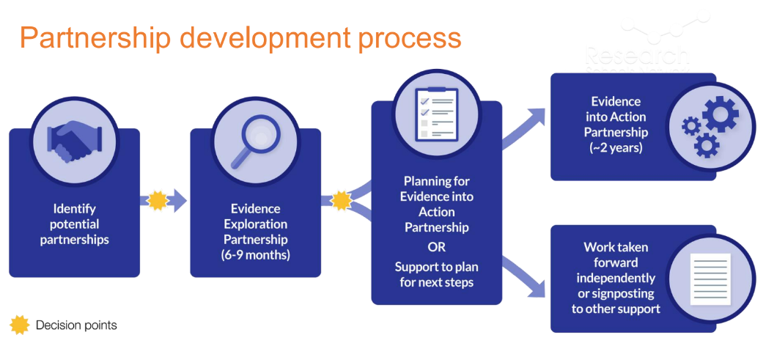
A new approach to partnerships

Slide 28
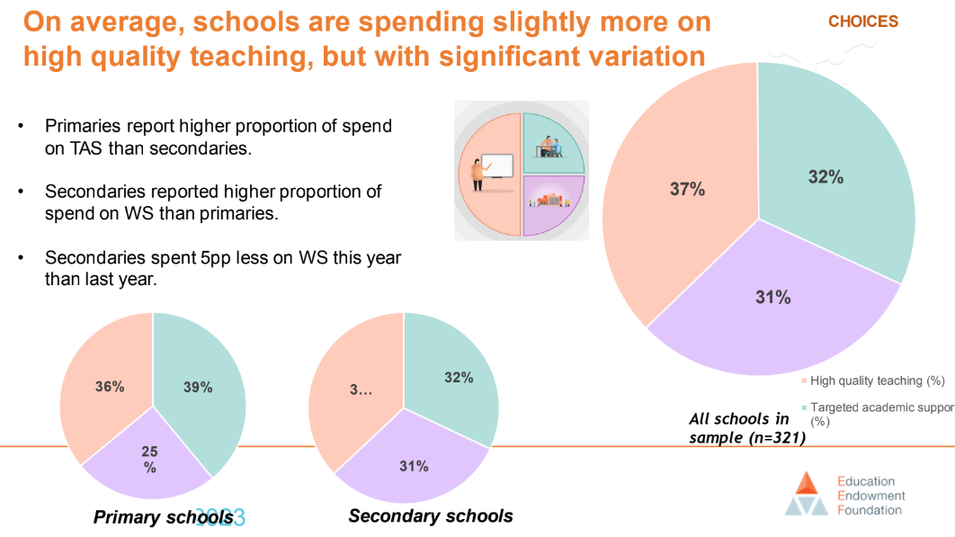

Slide 29
This is the range of guidance reports and other evidence reviews.
Do any of these fit with school improvement priorities?
Is this an opportunity to work with the Research School to align with the evidence recommendations?
Preparing for Literacy
Improving Literacy in KS1/2
Improving Literacy in secondary schools
Effective professional development
Implementation
Working with parents to support children’s learning
Making best use of teaching assistants
Teacher feedback to improve pupil learning
SEN in mainstream schools
Improving social and emotional learning
Improving behaviour
Metacognition
Improving Maths in EY and KS1/KS2/3
Improving Secondary Science
Cognitive science
Great Teaching
Pupil Premium
Also see the new Early Years Store
How can we utilise the expertise and capacity of Research Schools to support TSIO?
Any questions?

Slide 30
Webinar video:
Extract shown at GHAT TSIO meeting
(14:20 – 20:18 mins of webinar)
Full webinar

Slide 31
Feedback…
Do capture any feedback to us on these Hub updates
Thank you
Next – National positioning of ‘Strong Trusts’ and NLEs

Slide 32
Strong trusts as a source and provider of system leadership capacity.

Slide 33
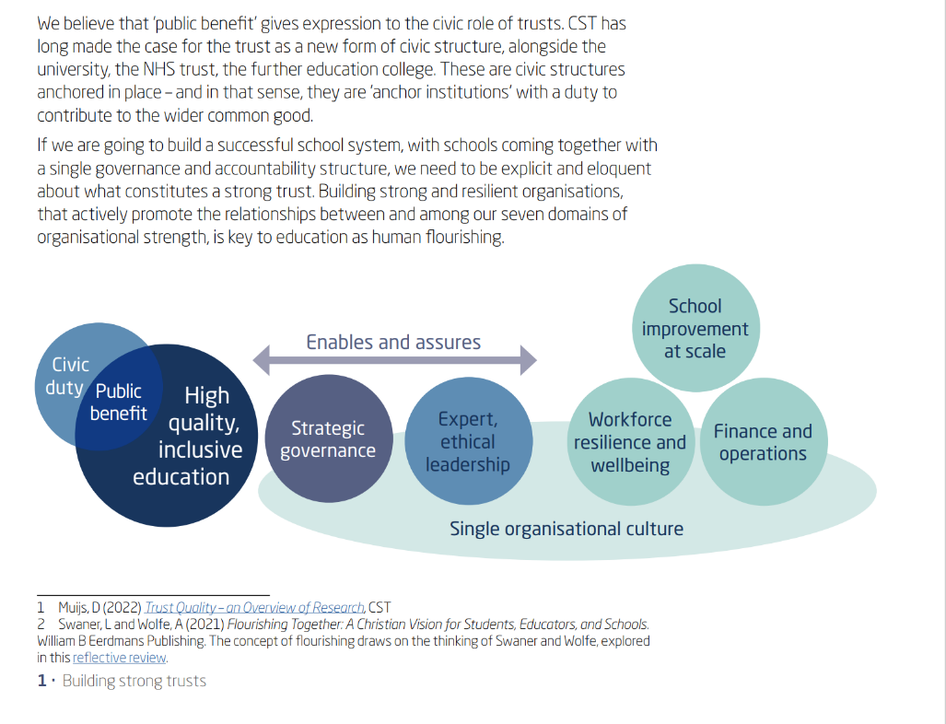
Building strong and resilient organisations is key to education as a way of promoting human flourishing: CST 2022
And we need to think about the flourishing of our schools working together in deep and purposeful collaboration as one entity, under a single governance structure, to improve and maintain high educational standards across a trust. In our view, deep and purposeful collaboration is at the heart of the trust structure – it is the way we keep the focus on improvement at scale. And from our point of view, structures are in fact very important because they create the conditions for this intensely focused collaboration.

Slide 34
4. School Improvement at Scale - working beyond our trust:
As school trusts emerge as civic structures, we see an opportunity for them to be anchor institutions in their communities: CST 2022/23
Part of the culture of the trust is to work beyond its own organisation with other trust leaders and civic actors for the wider common good. The primary focus on education quality as the quality of teaching is absolutely necessary but not sufficient. Education has wider purposes in intellectual, social, and cultural development; the formation of character; and helping pupils to understand and play a role in society and contribute to the wider common good. Many of the strongest trusts are explicit in their commitment to creating the conditions for human flourishing.

Slide 35
For Information
Academies Regulatory and Commissioning Review
The DFE March ‘23 published the Academies Regulatory and Commissioning Review.
Academies regulatory and commissioning review (publishing.service.gov.uk)
The review has looked at how to maximise the difference that academy trusts make to children's lives, so parents and carers can be confident that their child will receive a high-quality education wherever they live.
It includes references to a series of new Trust Development Statements setting out the priorities in each Education Investment Area (EIA) for developing a trust landscape led by high-quality trusts to transform standards locally and turn around underperforming schools.

Slide 36
Additional DfE policy guidance – March 2023
Recommended reference
CST membership promoted this link and it is available on demand: Unpacking the Academies Regulatory and Commissioning Review (on24.com)
Browne Jacobson webinar: Unpacking the Academies Regulatory and Commissioning Review Browne Jacobson hosted a CST webinar to help get under the surface of the proposed changes to the regulatory and commissioning review published by the DfE in late March and help trust leaders understand how they’ll affect you. The webinar considered:
The proposal to make regulatory oversight simpler
The changes to commissioning decisions by Regional Directors and the change of language from “strong trust” to “trust quality”
Proposals relating to supporting a self-improving system.

Slide 37
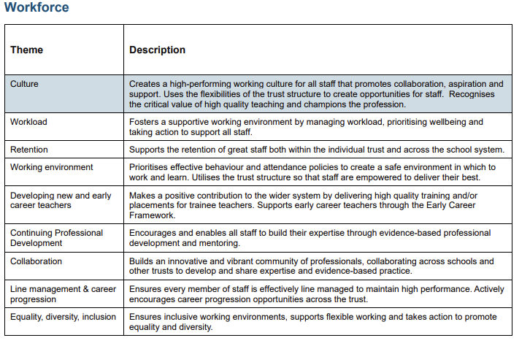
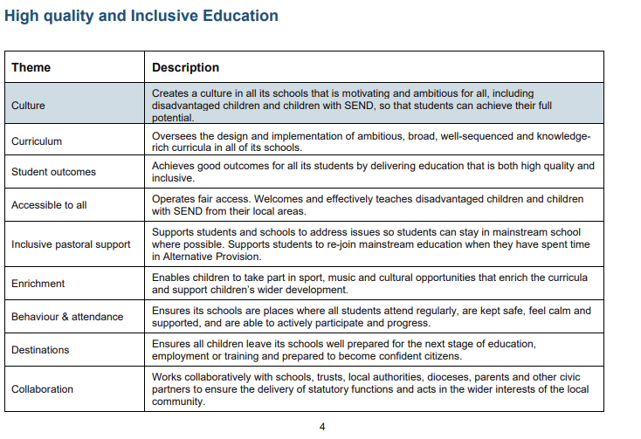
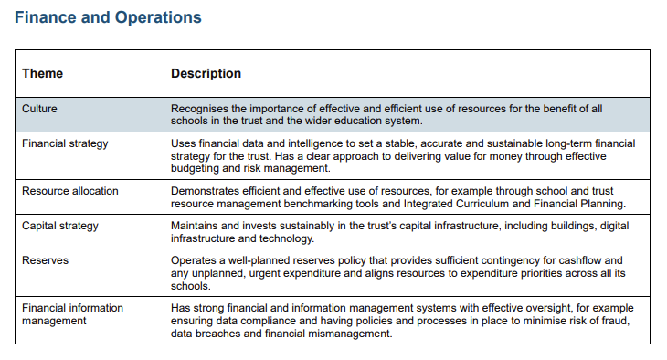
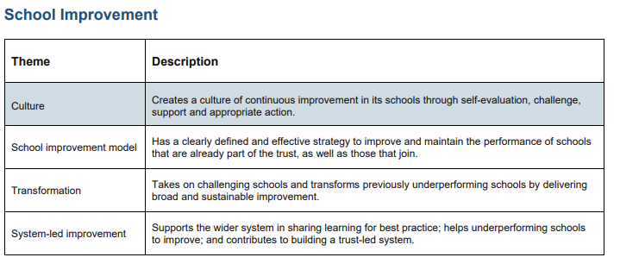
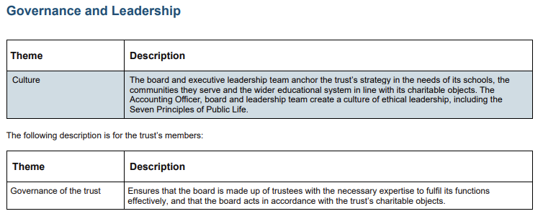
The White Paper’s five pillars of quality for MATS … revisited as Trust Quality Descriptors - April ‘23

Slide 38
National Leaders of Education: newly recruited for 2022/23 National leaders of education: a guide for potential applicants - GOV.UK (www.gov.uk)
“Over recent years, there has been a dramatic slowing down in the closure of the disadvantage gap (at the end of Year 11)… the five-year rolling average now suggests that it would take 560 years to close the gap…an increase in the gap in 2018 suggest(s)…that we could be at a turning point and that we could soon enter a period where the gap starts to widen.” –(EPI, 2019)
“Socio-economic attainment gap remains stubbornly wide after the pandemic, with reading skills particularly affected.” - EEF November 2022
“The quality of teaching is by far the biggest factor within schools that can make a difference to the achievement of children and young people.” (Coe et al., 2014)
“School leadership has a significant effect on features of the school organisation which positively influences the quality of teaching and learning…this leadership effect is vital to the success of most school improvement efforts.” (Leithwood, Harris & Hopkins, 2019)
Congratulations to those who have been successful and we can now share the new list of NLEs which replaces all current NLEs, whose designations have now finished as of August 2022.

Slide 39
Support for the TSIO system leaders and eligible schools/trusts
New NLEs supporting TSIO in the NW and YH:
NORTH WEST
First Name | Surname | Email | School | Trust/Federation
Des | Bird | dbird@workingtonacademy.org | Workington Academy | Cumbria Education Trust
Lisa | Fathers | lfathers@bright-futures.co.uk | Altrincham Grammar | Bright Futures Educational Trust
Lisa | Finnegan | lfinnegan@penninetrust.org |  | The Pennine Trust
Martin | Johnson | martin.johnson@dioceseofsalford.org.uk | Sacred Heart RC Primary School
Mylene | McGuire | head@stmaryslevenshulme.org.uk | St Mary's RC Primary School Manchester | The Federation of St Cuthbert's and St Mary's
Dominic | McKeon | dmc@little-lever.bolton.sch.uk | Little Lever School | Lever Academy Trust
Helena | Miller | h.miller@st-wilfridscofe.manchester.sch.uk | St. Wilfrids C Of E Primary School | St James and Emmanuel Academy Trust
Barbara | Rogers | barbara.rogers@salford.gov.uk | St Patrick's RC High School
Rebecca | Smith | rsm@salegrammar.co.uk | Sale Grammar School | Sale Grammar School (SAT)
Yorkshire and the Humber
First Name | Surname | Email | School | Trust/Federation
Helen | Broad | helen.broad@astreaintake.org | Intake Primary Academy | Astrea Academy Trust
Emily | Clark | principal@victoria.doncaster.sch.uk | Edlington Victoria Academy | Exceed Learning Partnership
Elaine | Silson | silsone@allertonhigh.org.uk | Allerton High School
June | Turner | june.turner@stf.beecroft.leeds.sch.uk | Beecroft Primary School
Chris | Stewart | headteacher@hallam.sheffield.sch.uk | Hallam Primary School | Tapton school academy Trust
Adam | Ryder | adam.ryder@morley.leeds.sch.uk | The Morley Academy | Gorse Academies Trust
Marc | Cooper | mcooper@smchull.org | St Mary’s College Hull | St Cuthberts RC Academy Trust

Slide 40
For Information
MAT Leadership Development - note CEO content framework

Slide 41
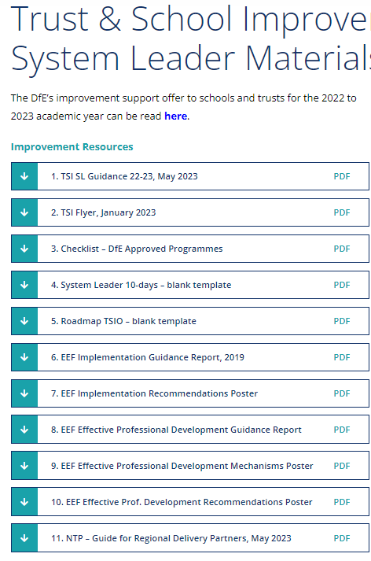
Gathering your feedback on your involvement with TSIO delivery so far
Plenary.
What’s working well ?
Where do you need more information ?
Feedback on newsletters and
system leader material bank of
resources.
Even better if …..

